Slide 1
Orion
Packets
APPEAL * TRANSFER * PROPERTY

Slide 2
Counties Utilizing Orion Packets
Yes
No
What counties are utilizing Orion Packets?
41%
45%
Other
14%
22 Counties Responded

Slide 3
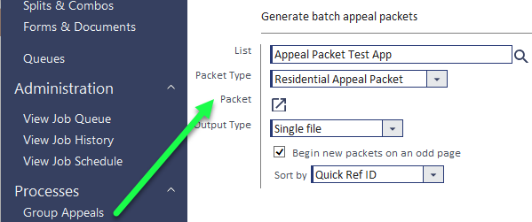
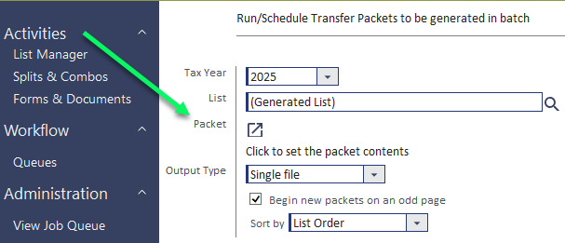
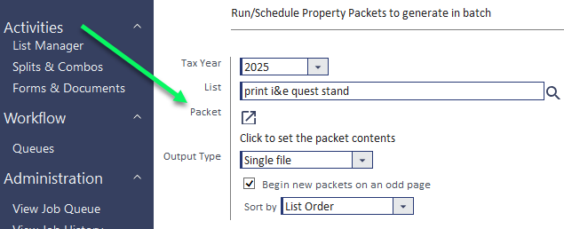
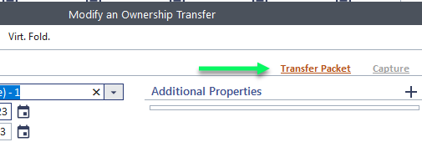
Packet Types
Appeal
Transfer
Property

Slide 4
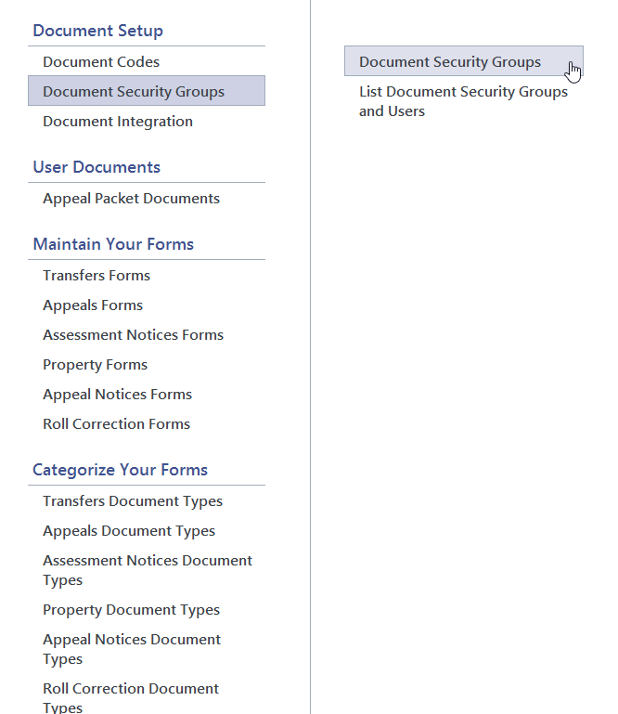
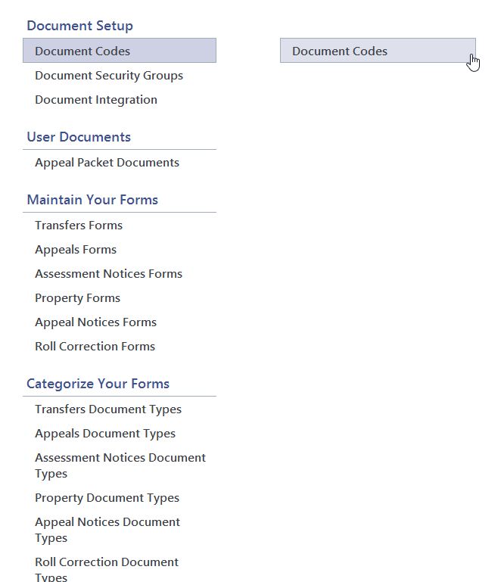
Getting Started

Slide 5
Step One
01/03
Setup Document Codes, Types and Security:
Categorize documents by creating Document Codes
These categories are setup by the user and business process needs – to security settings
Specific documents can be pulled into packets based upon the code
Categorize forms by creating Document Types
These categories are separated by Transfers, Appeals, Assessment Notices, Property, Appeal Notices and Roll Correction Forms
Create subcategories within these forms based upon business process needs
Verify all users who have permissions to generate the packet have document security rights to it
Document Groups provide control over the users who will be allowed to create, view or run various types of documents.
Select the Document Security Groups option in the Manage Forms menu under Document Setup to access and assign security groups
When saving a new Document Code, a security prompt will launch
Setup Map configurations if using GIS Maps in the packet
DOCUMENT CODES
DOCUMENT SECURITY GROUPS
MAP CONFIGURATIONS

Slide 6
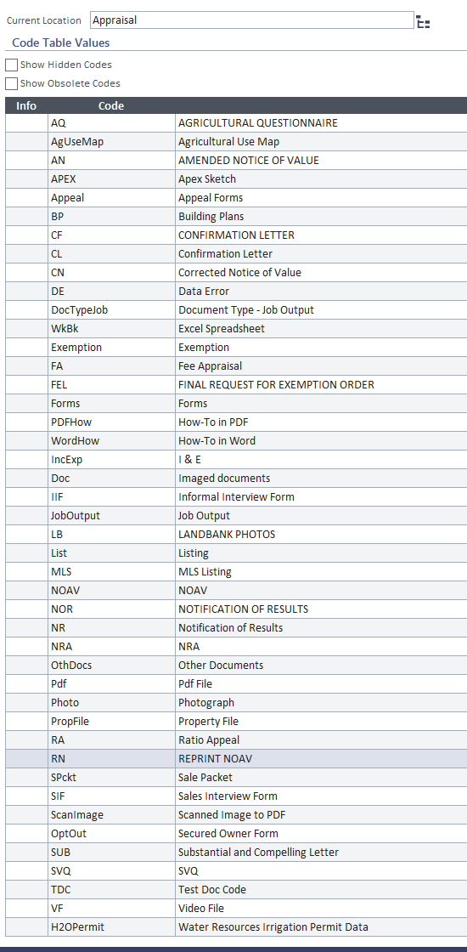
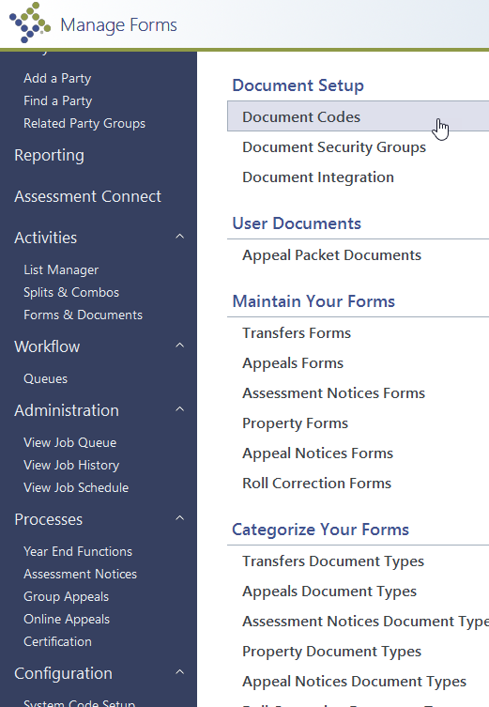
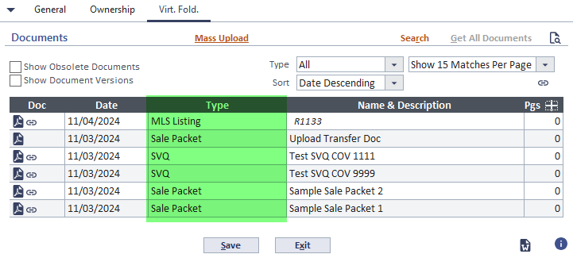
Under the Heading of Document Setup in the Forms & Documents menu option, Select Document Codes.
This will launch the Maintain Document Code page.
To add a document code, click the add icon on the grey table header. To view or modify an existing code, click the row in the table.

Slide 7
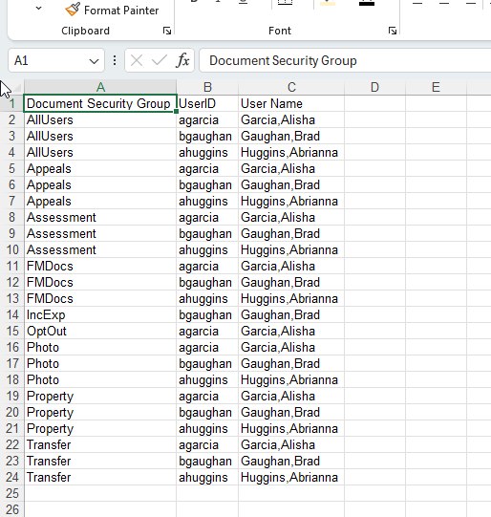
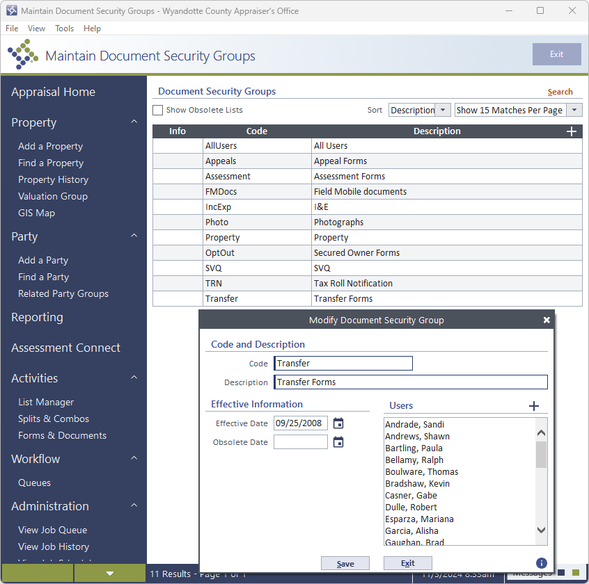
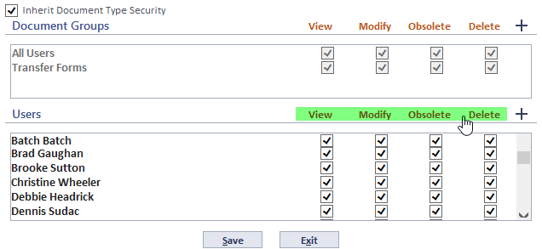
Document Security
Tip
To give columns rights to all instead of clicking each box, click on the orange Add, View, Modify, and or Obsolete to select all

Slide 8
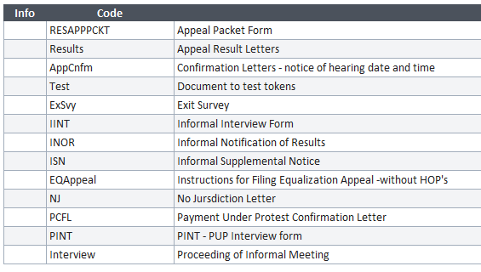
Document Types
Appeal Examples
Transfer
Property
Code Description
Deed Deed
Saleconf Sale Confirmation
Cover Sale Cover Sheet
SPkt Sale Packet*
SVQSummary Sale Report
SaleInt Sales Interview form
TRN Tax Roll Notification
Code Description
DC Data Collection
Prop Property
Code Description
RESAPPPCKT Appeal Packet Form
Results Appeal Result Letters
AppCnfm Confirmation Letters - notice of hearing date and time
Test Document to test tokens
ExSvy Exit Survey
IINT Informal Interview Form
INOR Informal Notification of Results
ISN Informal Supplemental Notice
EQAppeal Instructions for Filing Equalization Appeal -without HOP's
NJ No Jursdiction Letter
PCFL Payment Under Protest Confirmation Letter
PINT PUP Interview form
Interview Proceeding of Informal Meeting

Slide 9
Step Two
02/03
Determining Documents to include in the packet:
Create forms within Orion for documents that will be used frequently and would benefit from having fields auto populated from the tokens.
Pre-add generic documents to the User Documents that are not parcel specific but could be used for numerous parcels or areas such studies, profiles, ratio reports, generic publications, etc.
Know the file location of unique or parcel specific documents that need to be included in the packet.
Forms & Documents
User Documents
External Sources

Slide 10
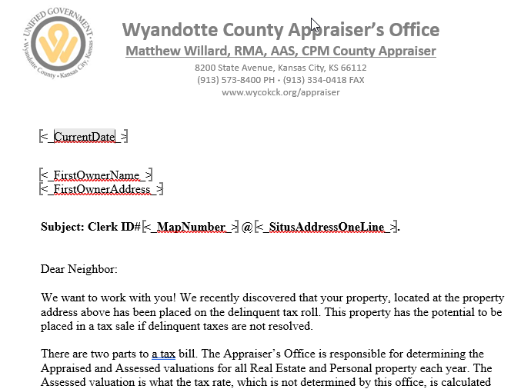
Orion Forms & Docs
Copy Paste
Table the Form
Security
Document Types
Set the page layout & margins before pasting from another source
Keep spacing
If a form is not visible to anyone who should have access to it – check the Document Security Groups
Create all necessary Document Types - great for pulling specific type documents and finding quickly
Keep token placement
Add more information without all the formatting hassle

Slide 11
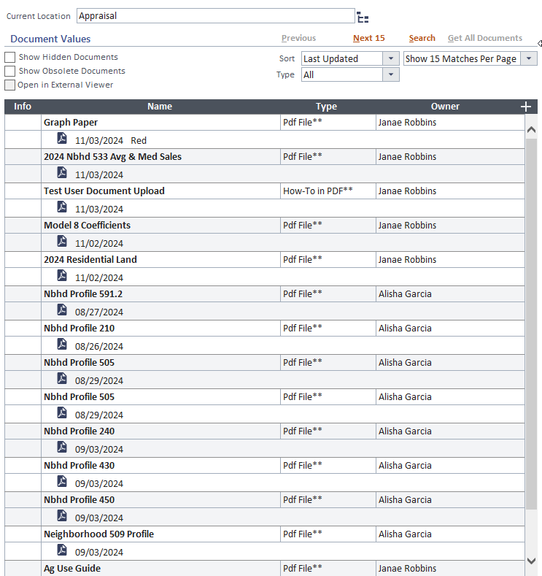
User Documents
Use:
Retains all User Documents added to Orion
Available for all packets (Appeal, Transfer, Property)
How to access:
when creating a packet
Forms & Documents
Tips
Name the User Documents when added into Orion – easier to find and reuse later
Purge if possible

Slide 12
Step Three
03/03
Build the packet:
Build the packet using Packet Items
Appeal:
Batch run in Group Appeals
Create packet from within Appeal on Document tab
Transfer:
Batch run from Activities
Create packet from within Transfer above Additional Properties
Property:
Batch run from Activities
Create packet from within parcel in expanded Property Header
Memorize packets - no need to keep recreating
Check the Settings options in the packet – this is where you can attach the packet to the record
BUILD THE PACKET
MEMORIZE
PACKET SETTINGS

Slide 13
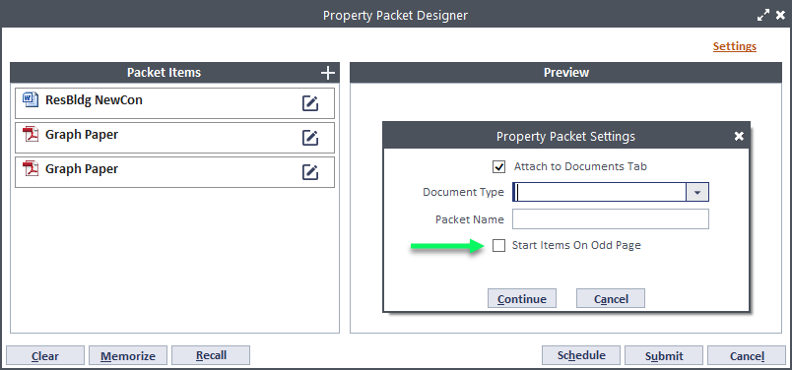
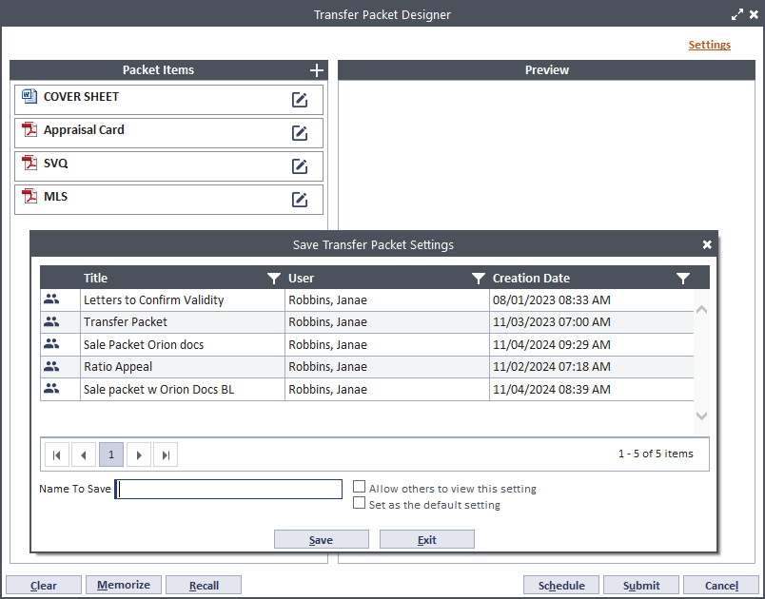
PACKET SETTINGS
Avoid adding blank sheets to separate files within the packet by checking the box Start Items On Odd Page.
Memorize
If you forget to set either Allow other to view this setting or Set as the default setting on a packet, Memorize the packet again and check the boxes.

Slide 14
Packet
Examples
Appeal
Transfer
Property
Informal Appeal Documents
Sale Packet Orion Docs
Comp Report w Descrip Grid
Informal Packet w 10 Day Waiver
Sale Packet Buyers Ltr
I & E Questionnaires
2024 SC Packet (Residential)
Ratio Appeal
Blank Ag Questionnaire w Guide
2024 CRE SC & BOTA Packet
Comp Report w Descrip Standard
Public Appeal Pckt w PRC Comp
ResBldg NewCon DC
Nbhd 533 Appeal example
PRC Comp Cost Income
2025 Land Informal Docs
OthImp PRC w Grid
PRC w Descrip Standard
Douglas Co Appeal
DgCoExhibit-2021-5987-EQ
2024-2355-EQSC-Dg-CoExhibit

Slide 15
Example
Transfer Packet
R340963
Virtual Tab:
2 SVQs/COVs
2 Sale Packets (after inspection)
TRANSFER PACKET ITEMS DEMO

Slide 16
Packet Items

Slide 17
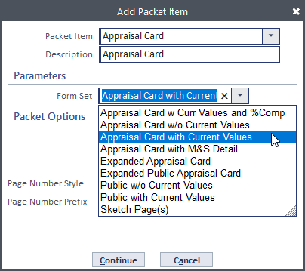
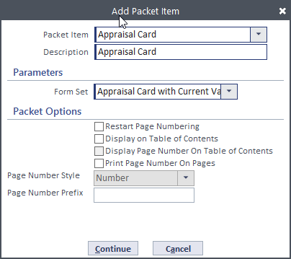
Appraisal Card: - select card type
Tax Year else Current if not versioned?

Slide 18
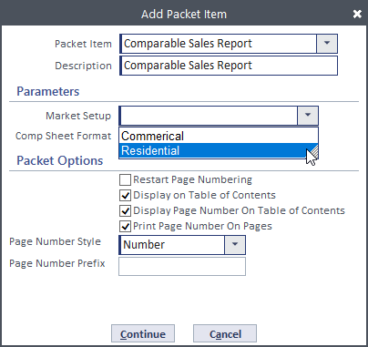
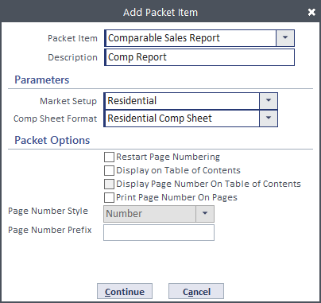
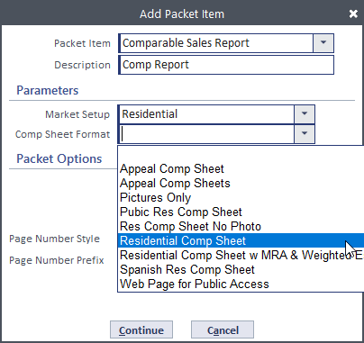
Comparable Sales Report: - select Market Setup and Comp Sheet Format

Slide 19
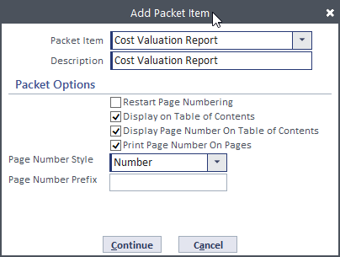
Cost Valuation Report: Cost Valuation Report

Slide 20
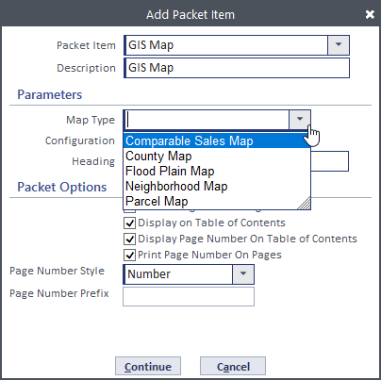
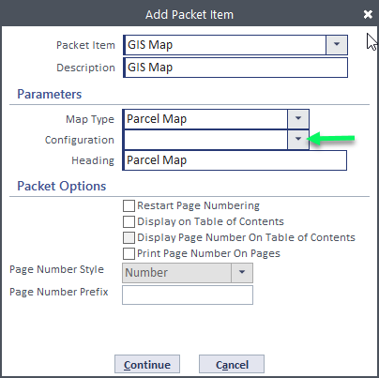
GIS Map: select Map Type, configuration, and Map Heading

Slide 21
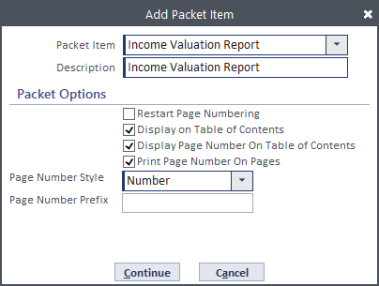
Income Valuation Report: Income Valuation Report

Slide 22
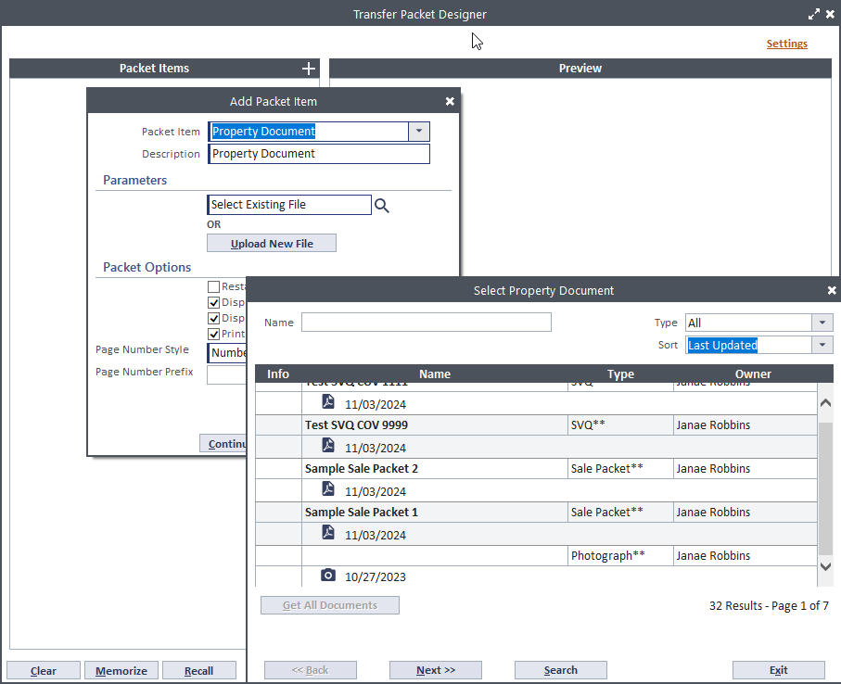
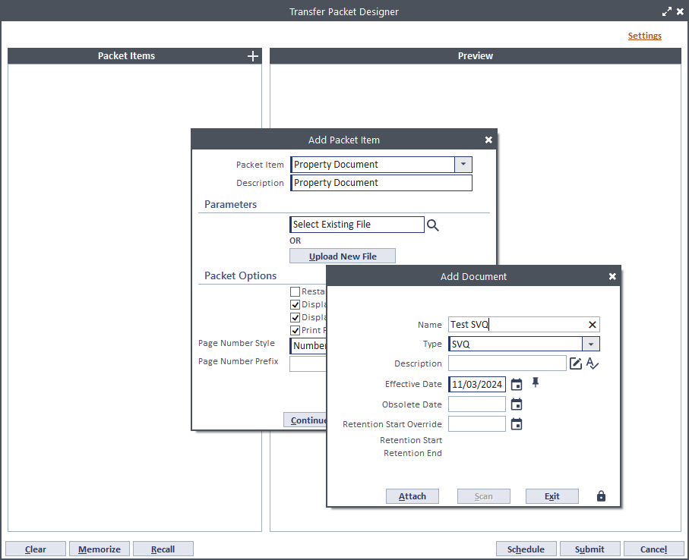
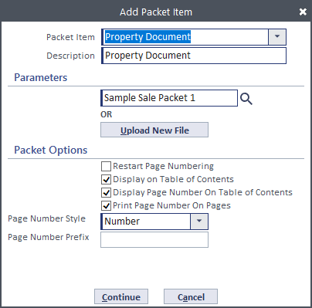
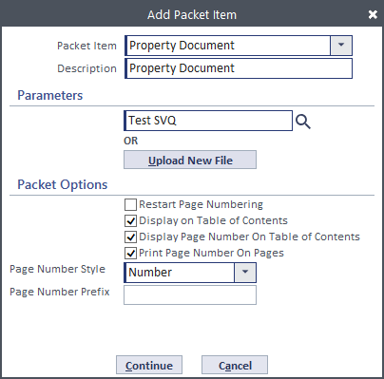
Property Document (from the Document’s tab): select one existing document or upload a new document (will automatically add to the Document tab)

Slide 23
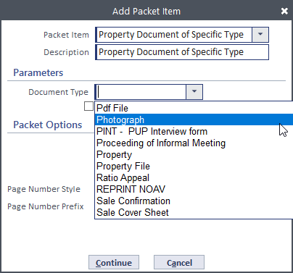
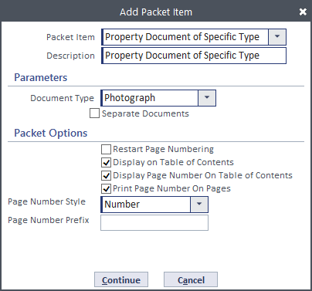
Property Document of Specific Type: - select the Document Type to include (will print all of that type so be careful). Great for photographs.

Slide 24
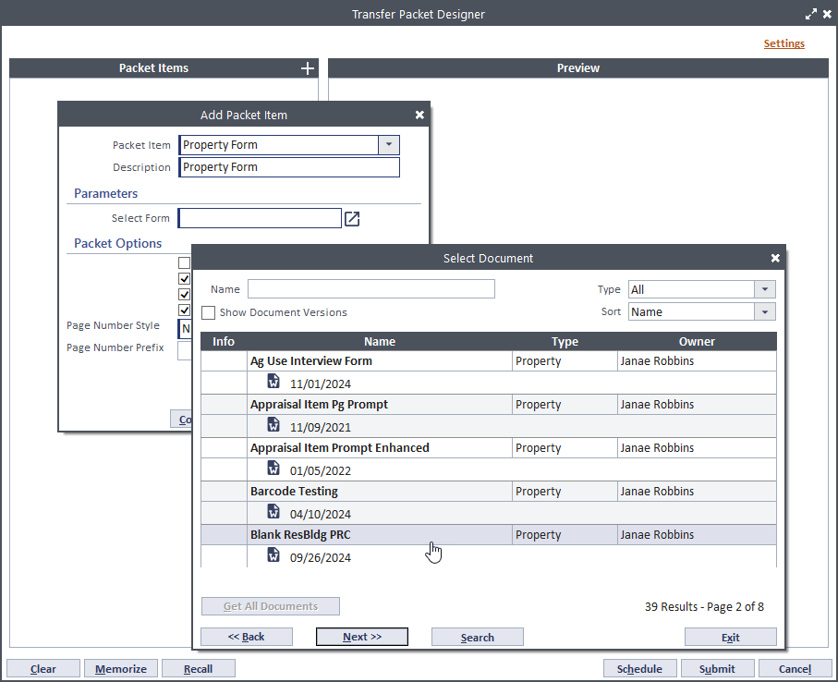
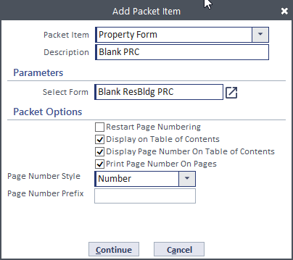
Property Form: - select a Property Form to generate
(from Forms & Docs)

Slide 25
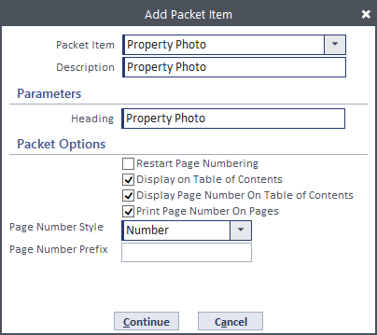
Property Photo: Property Photo, update Heading to display on sheet with photo else it will be Property Photo

Slide 26
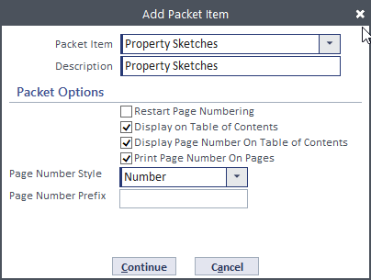
Property Sketches: Property Sketches

Slide 27
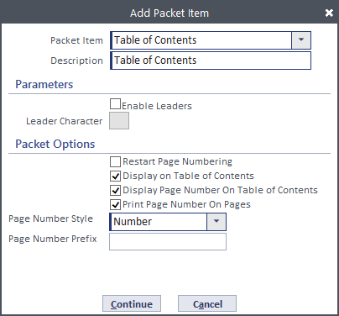
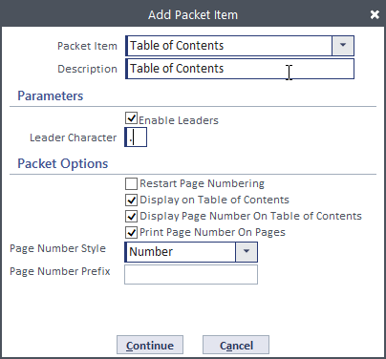
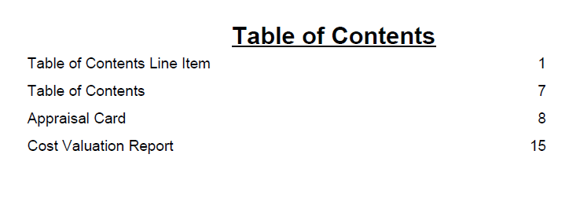
Table of Contents: Enable Leaders and add character if else it will be blank

Slide 28
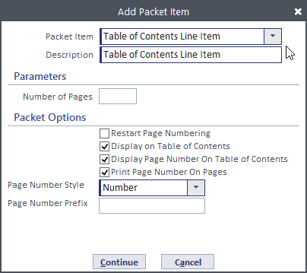
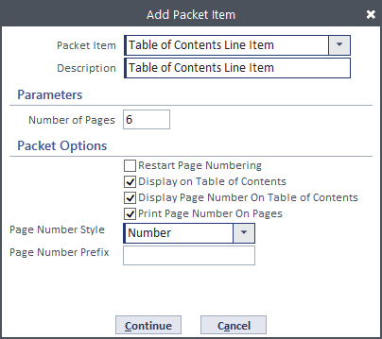
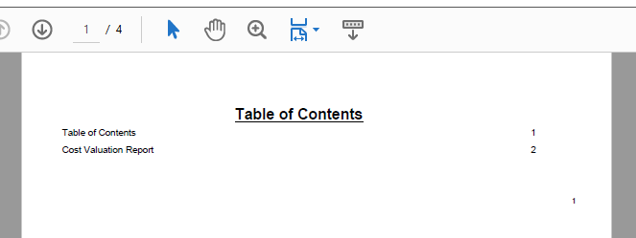
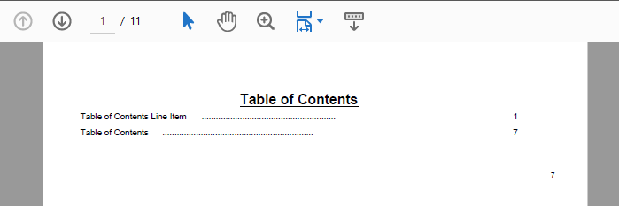
Table of Contents Line Item: Page numbering: will start the first page numbering after the set number.

Slide 29
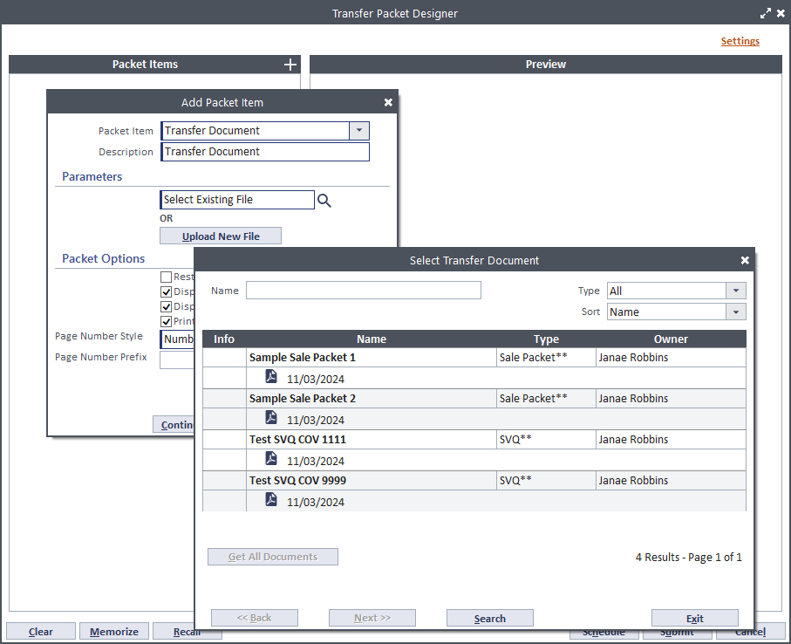
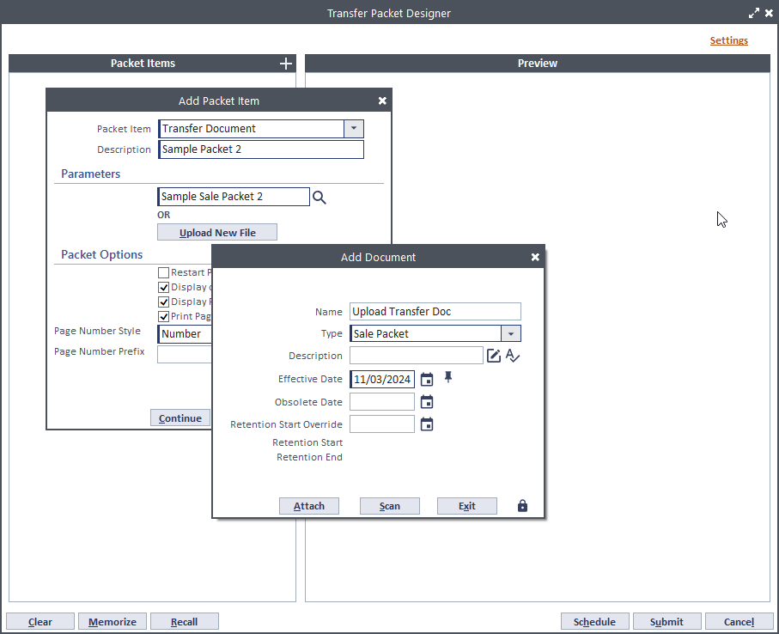
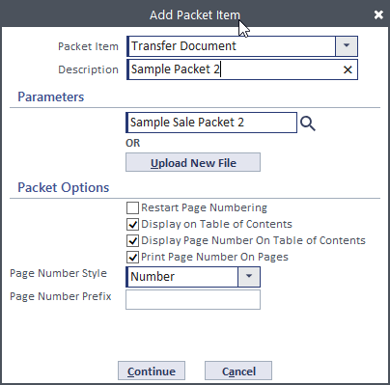
Transfer Document (from the Transfer tab – Virtual Folder): select one existing document or upload a new document (will automatically add to the Transfer’s Virtual tab and the Document tab)
Transfer Packet Only

Slide 30
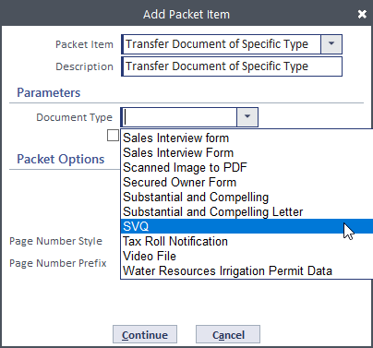
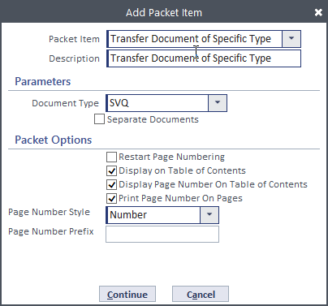
Transfer Document of Specific Type: - select the Document Type to include (will print all of that type in the Virtual Folder so be careful).
Transfer Packet Only

Slide 31
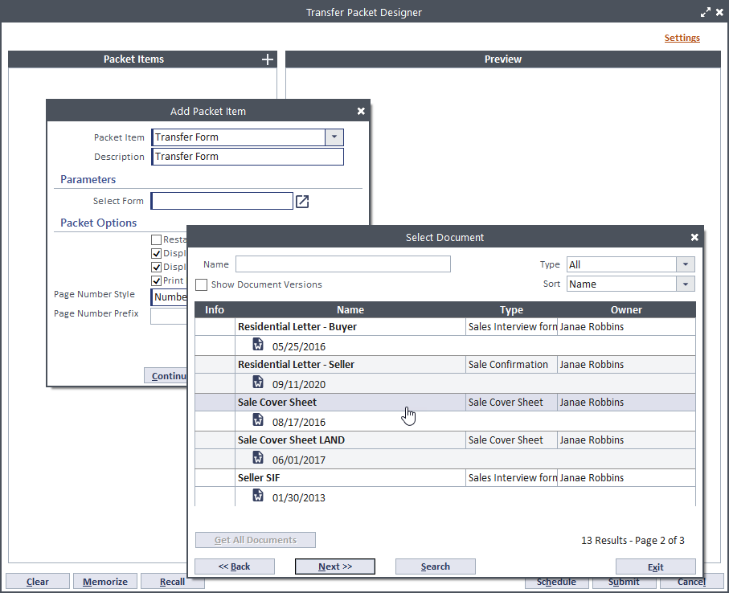
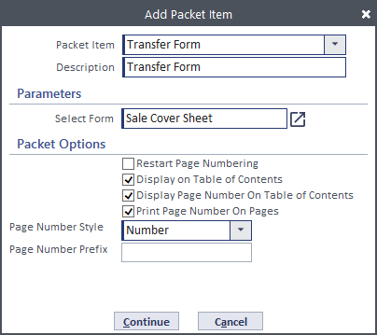
Transfer Form: - select a Transfer Form to generate
(from Forms & Docs)
Transfer Packet Only

Slide 32
User Document (from User Documents): select one existing document or upload a new document (will automatically add to the User Documents folder(?))

Slide 33
Appeal Document (from the Appeal tab – Virtual Folder): why is this not an option?
Appeal Packet Only

Slide 34
Appeal Document of Specific Type: - select the Document Type to include (will print all of that type in the Virtual Folder so be careful).
Appeal Packet Only

Slide 35
Appeal Form: - select an Appeal Form to generate
(from Forms & Docs)
Appeal Packet Only

Slide 36
Income Approach Report: Income Approach Report

Slide 37
Valuation and Appeal History: enter number of years to go back on the report.

Slide 38
Valuation Indication and Selection Statement: - add statement to display on Valuation and Appeal History report.

Slide 39
Thank You
for watching
Get in touch:
Phone: 123-456-7890
Web: reallygreatsite.com
Email: hello@reallygreatsite.com
Social: @reallygreatsite
Address: 123 Anywhere St., Any City, ST 12345

Slide 41
Packet Items
Your Item Goes
Right in this Box Here

